Slide 1
MGS 425 (S1S & S2S)
Management of it projects
Week 10 – April 5th

Slide 2
Agenda
Chapter 17 – Product Planning/Envisioning
Chapter 18 – Release Planning
TopHat Assignment for this week is due by end of day on Sunday, 4/11.

Slide 3
Product planning/Envisoning
Chapter 17

Slide 4
Product Planning
Chapter Outline
Overview
  Timing
  Participants
  Process
SR4U Example
Visioning
High-Level Product Backlog Creation
Product Roadmap Definition
Other Activities

Slide 5
Product Planning
Chapter Outline
Economically Sensible Envisioning
  Target a Realistic Confidence Threshold
  Focus on a Short Horizon
  Act Quickly
  Pay for Validated Learning
  Use Incremental/Provisional Funding
  Learn Fast and Pivot (aka Fail Fast)
Closing

Slide 6
Product Planning - Overview
Let’s say you have an intriguing idea for a new product or the next version of an existing product.
The goal of envisioning is to expound upon that idea, describing the essence of the potential product and creating a rough plan for how to approach its creation.
At the end of envisioning, you should have sufficient confidence to subject the idea to portfolio planning (see Chapter 16), where you can decide whether you want to fund the next level of more detailed development.
Envisioning a product in Scrum should not be confused with heavier-weight, ceremonial, plan-intensive project chartering.
With Scrum, we don’t believe that we can (or should try to) know all the details about a product before we start.

Slide 7
Product Planning - Overview
However it is understood that product funding usually can’t move forward without first having a vision; enough details to understand the customers, features, and high-level solution; and an idea of how much the product might cost.
We don’t spend too much time or effort envisioning because we want to quickly advance past the guessing stage, where we think we know the needs of the customer and the potential solution, to the fast-feedback stage—the customer-value-creation sprints.
It’s only when we actually start implementing the solution through a continuous cycle of interactions with our complex environment that we acquire validated learning based on the reality in which our product must exist and thrive.

Slide 8
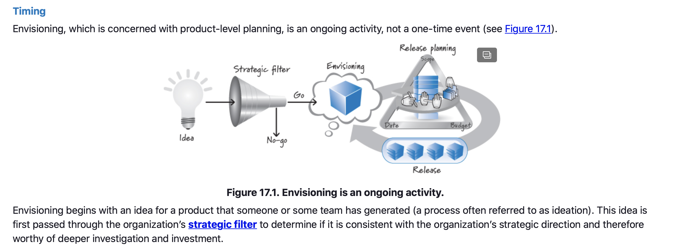
Product Planning – Timing

Slide 9
Product Planning - Timing
Once the idea has cleared the strategic filter, we do initial envisioning.
During this process, we generate enough understanding of the desired future product to define what the minimal first release should be. Doing so allows us to deliver high value quickly and at a low cost.
It also puts something tangible in the hands of the actual users and customers as soon as possible, giving us actionable feedback to confirm or refute the assumptions we made about the target customers, the desired set of features, and our overall solution.
This feedback might be in line with our expectations, reinforcing our desire to persevere with our current vision. On the other hand, it could just as easily be completely different from what we expected, which would cause us to pivot from our original solution, re-envision what we are doing, and modify the plan accordingly.

Slide 10
Product Planning - Participants
The product owner is the only required participant during initial envisioning.
Normally, though, the product owner oversees an initial envisioning that includes one or more internal stakeholders, who collaborate with the product owner to perform the envisioning work.
In addition, specialists in areas such as market research, business-case development, user-experience design, and systems architecture frequently participate in various envisioning tasks as well.
If the Scrum team has been formed, it would benefit the process to include them also. However, Scrum teams are not typically formed until after the product has been funded.
Once product development is under way and the full Scrum team has been allocated, however, the full Scrum team (product owner, ScrumMaster, and development team) should be included in any re-envisioning efforts.

Slide 11
Product Planning - Process
The main input for initial envisioning is an idea that has cleared the strategic filter.
The main input for re-envisioning, on the other hand, would be a pivoted idea. Such an idea is one that has been updated or revised based on user or customer feedback, funding changes, unpredictable moves by competitors, or other important changes that occur within the complex environment in which ideas must exist.
Other inputs are needed, as well:
  An indication of the planning horizon—how far into the future we should consider when we envision.
  The expected completion date for the envisioning activities (if there is one), and the quantity and type of resources available to conduct envisioning.

Slide 12
Product Planning - Process
Other inputs are needed, as well:
  Lastly, we need to know the confidence threshold—the “definition of done” for envisioning, if you will.
    The confidence threshold is the set of information that the decision makers need in order to have enough confidence to make a go/no-go funding decision for more detailed development.

Slide 13
Product Planning – SR4U Example
To illustrate the envisioning activity we will use a fictitious new product idea called SmartReview4You (or simply SR4U).
The company, Review Everything, Inc., is a leader in online, consumer-supplied product and service reviews. Its core business is to provide a forum for people to exchange product and service reviews.
Review Everything’s revenues have been growing at a modest pace for the past several years and it is profitable. However, the company has many competitors that release innovative features with alarming frequency.
Review Everything really needs a new, innovative service offering to leapfrog the competition.

Slide 14
Product Planning – SR4U Example
Review Everything has a dedicated marketing team that constantly monitors the social media space to see how customers perceive its current services.
In doing so, the team has learned that many users report spending too much time on the Review Everything site separating “authentic” reviews from “suspicious” reviews.
Additionally, many users say that there are so many reviews available for certain products (for example, a DVD player) or services (for example, the Chinese restaurant on Main Street) that they find it difficult to wade through them to get an accurate overall picture.

Slide 15
Product Planning – SR4U Example
This market intelligence leads to the idea for SR4U, a revolutionary way to identify, filter, and display online reviews that includes a trainable search agent.
Marketing believes this idea could be the innovative service offering that Review Everything has been seeking.
Marketing writes a one-page description of SR4U that includes its high-level target features, target customers, and key advantages.
The team then sends this description to the New Product Approval Committee, which reviews it at its regularly scheduled Idea Review Meeting (held the second Wednesday of every month).

Slide 16
Product Planning – SR4U Example
Senior management (which makes up the New Product Approval Committee) agrees that SR4U represents a significant opportunity to differentiate Review Everything, Inc., in the marketplace.
The committee then designates Roger, a business representative from strategic marketing, as the product owner for SR4U.
Management has authorized two weeks to complete envisioning, at which time members of the approval committee will review the envisioning results and make a go/no-go decision to fund the initial development of SR4U.
In addition to Roger, management has authorized two filtering subject matter experts (SMEs), a market researcher, and a number of stakeholders to participate in the envisioning. The larger expenditure of the full Scrum team during envisioning has not yet been authorized.

Slide 17
Product Planning – SR4U Example
Roger is being asked to use the resources available to him to produce the following:
  Initial product vision, product backlog, and product roadmap
  Validation of the primary assumption that users significantly prefer SR4U-filtered results to unfiltered results (Later in the chapter I will describe how Roger and his colleagues will provide this validated learning.)
  A description of the other important assumptions (hypotheses) about the potential users and feature set that the first product release is supposed to test
  The few key, actionable measures used to test the other assumptions and to learn whether the initial release of SR4U is meeting expectations
  List of questions (known unknowns) that need to be addressed
Without this information, senior management would not have sufficient confidence to make an informed decision as to whether or not to move forward with the initial development.

Slide 18
Product Planning – Visioning
The first thing Roger and the stakeholders do is to create a shared, compelling vision for SR4U.
In Scrum, a vision is not an elaborate, several-hundred-page document. If we need this much space to describe our vision, we probably don’t understand it.
Visions, even of complex products, should be simple to state and should provide a coherent direction to the people who are asked to realize them.

Slide 19
Product Planning – Visioning
Take, for example, President Kennedy’s vision to go to the moon: “I believe that this nation should commit itself to achieving the goal, before this decade is out, of landing a man on the Moon and returning him safely to the Earth” (Kennedy 1961 https://youtu.be/GhgVZLrxiu0?t=132)
In 31 words Kennedy was able to express an aggressive, unambiguous vision that, to be realized, would eventually require the efforts of thousands of collaborating people building many complex systems with hundreds of thousands of interrelated components.
When developing products or services, the vision is frequently expressed in terms of how the stakeholders get value.

Slide 20
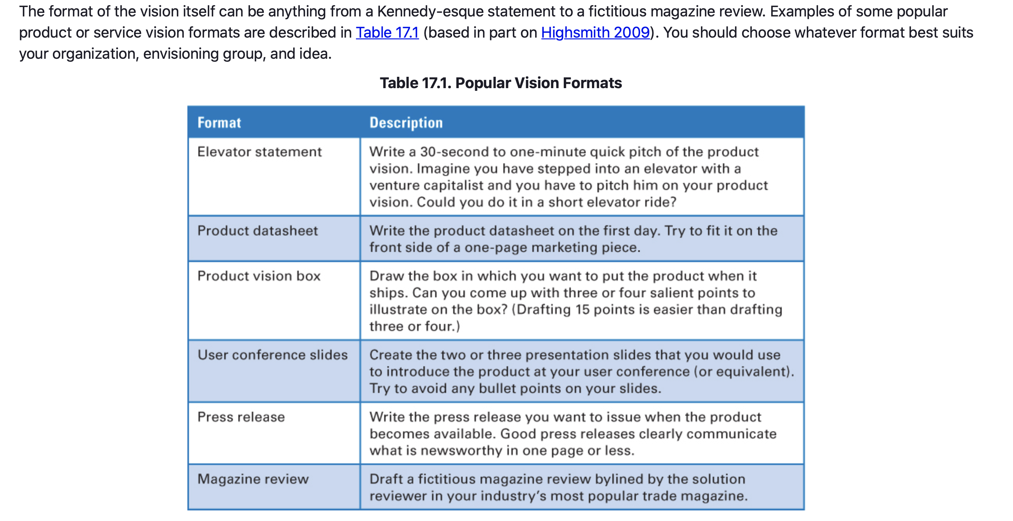
Product Planning – Visioning

Slide 21
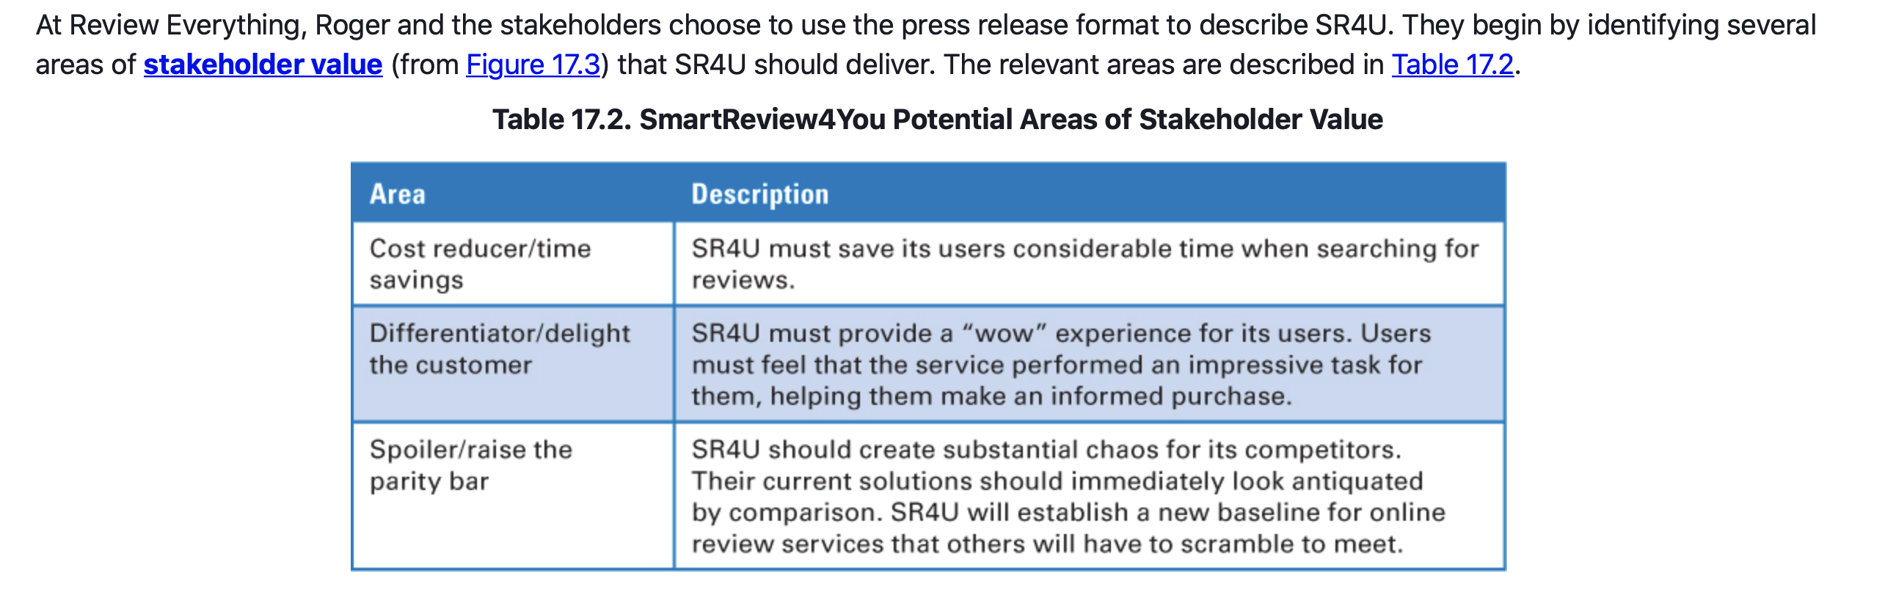
Product Planning – Visioning

Slide 22
Product Planning – High-Level Product Backlog Creation
Once we have a vision, we are ready to create high-level product backlog items.
Although there are many ways to represent product backlog items, we prefer to use user stories.
In the terminology of user stories, during envisioning I want to create epics—really large user stories that are consistent with the product level of planning.
These epic-level stories align with the vision and provide the next level of product detail for senior management and the Scrum team.
The people who write these stories are usually the same people who created the vision—the product owner, stakeholders, and preferably the ScrumMaster and development team, if they are available.

Slide 23
Product Planning – Product Roadmap Definition
Once we have the initial vision and a high-level product backlog, we can define our initial product roadmap, a series of releases for achieving some or all of our product vision.
Recall that when using Scrum, we always develop incrementally.
We also try to deploy incrementally when that approach is sensible, meaning we focus on smaller, more frequent releases where we deliver some of the solution before we deliver all of the solution.
A product roadmap is an initial overview of these incremental deployments.

Slide 24
Product Planning – Product Roadmap Definition
Releasing frequently doesn’t mean we set overly aggressive deadlines; such deadlines frequently result in missed dates.
Instead, we focus each release on a small set of minimum releasable features (MRFs) around which the stakeholder community shares a strong group consensus.
MRFs represent the smallest set of “must-have” features—the features that simply have to be in the release if we are to meet customer value and quality expectations.
Some people refer to this set of features as the minimum viable product (MVP) or minimum marketable features (MMFs).
While we might choose to deliver more than the MRFs in a given release, customers would not perceive enough value if we delivered any fewer. Therefore, it is always important to define the minimum set.

Slide 25
Product Planning – Other Activities
Envisioning can include any other type of work that those involved agree is relevant to achieving the target confidence threshold.
Perhaps we want to do minimal market research into the target customers or users.
Or maybe we want to do a quick competitive analysis of the proposed product against other offerings in the marketplace.
Or perhaps we want to create a rough business model to help us decide whether the product passes the organization’s “economic filter.”

Slide 26
Product Planning – Economically Sensible Envisioning
Envisioning needs to be carried out in an economically sensible way.
It should be viewed as an investment in acquiring the information necessary for management to make an informed decision about whether to fund the work required for developing a product based on the idea.
If we do too little envisioning, we might find ourselves unprepared to do the first customer-value-creation sprint.
On the other hand, doing too much envisioning will create a large inventory of product-planning artifacts that may have to be reworked or discarded when we start to acquire validated learning.

Slide 27
Product Planning – Economically Sensible Envisioning
In Scrum, we keep envisioning as simple as possible.
We do just enough up-front predictive planning and knowledge-acquisition work based on the product’s nature, size, and risk level.
We allow the details of some other artifacts to be created in a just-in-time fashion.
Our goal is to make the best decision we can today using reasonable information obtained in a financially and time-sensitive manner.
We acknowledge that what we think we know about the product can and will change once we actually build something and start to subject it to customer and user scrutiny.

Slide 28
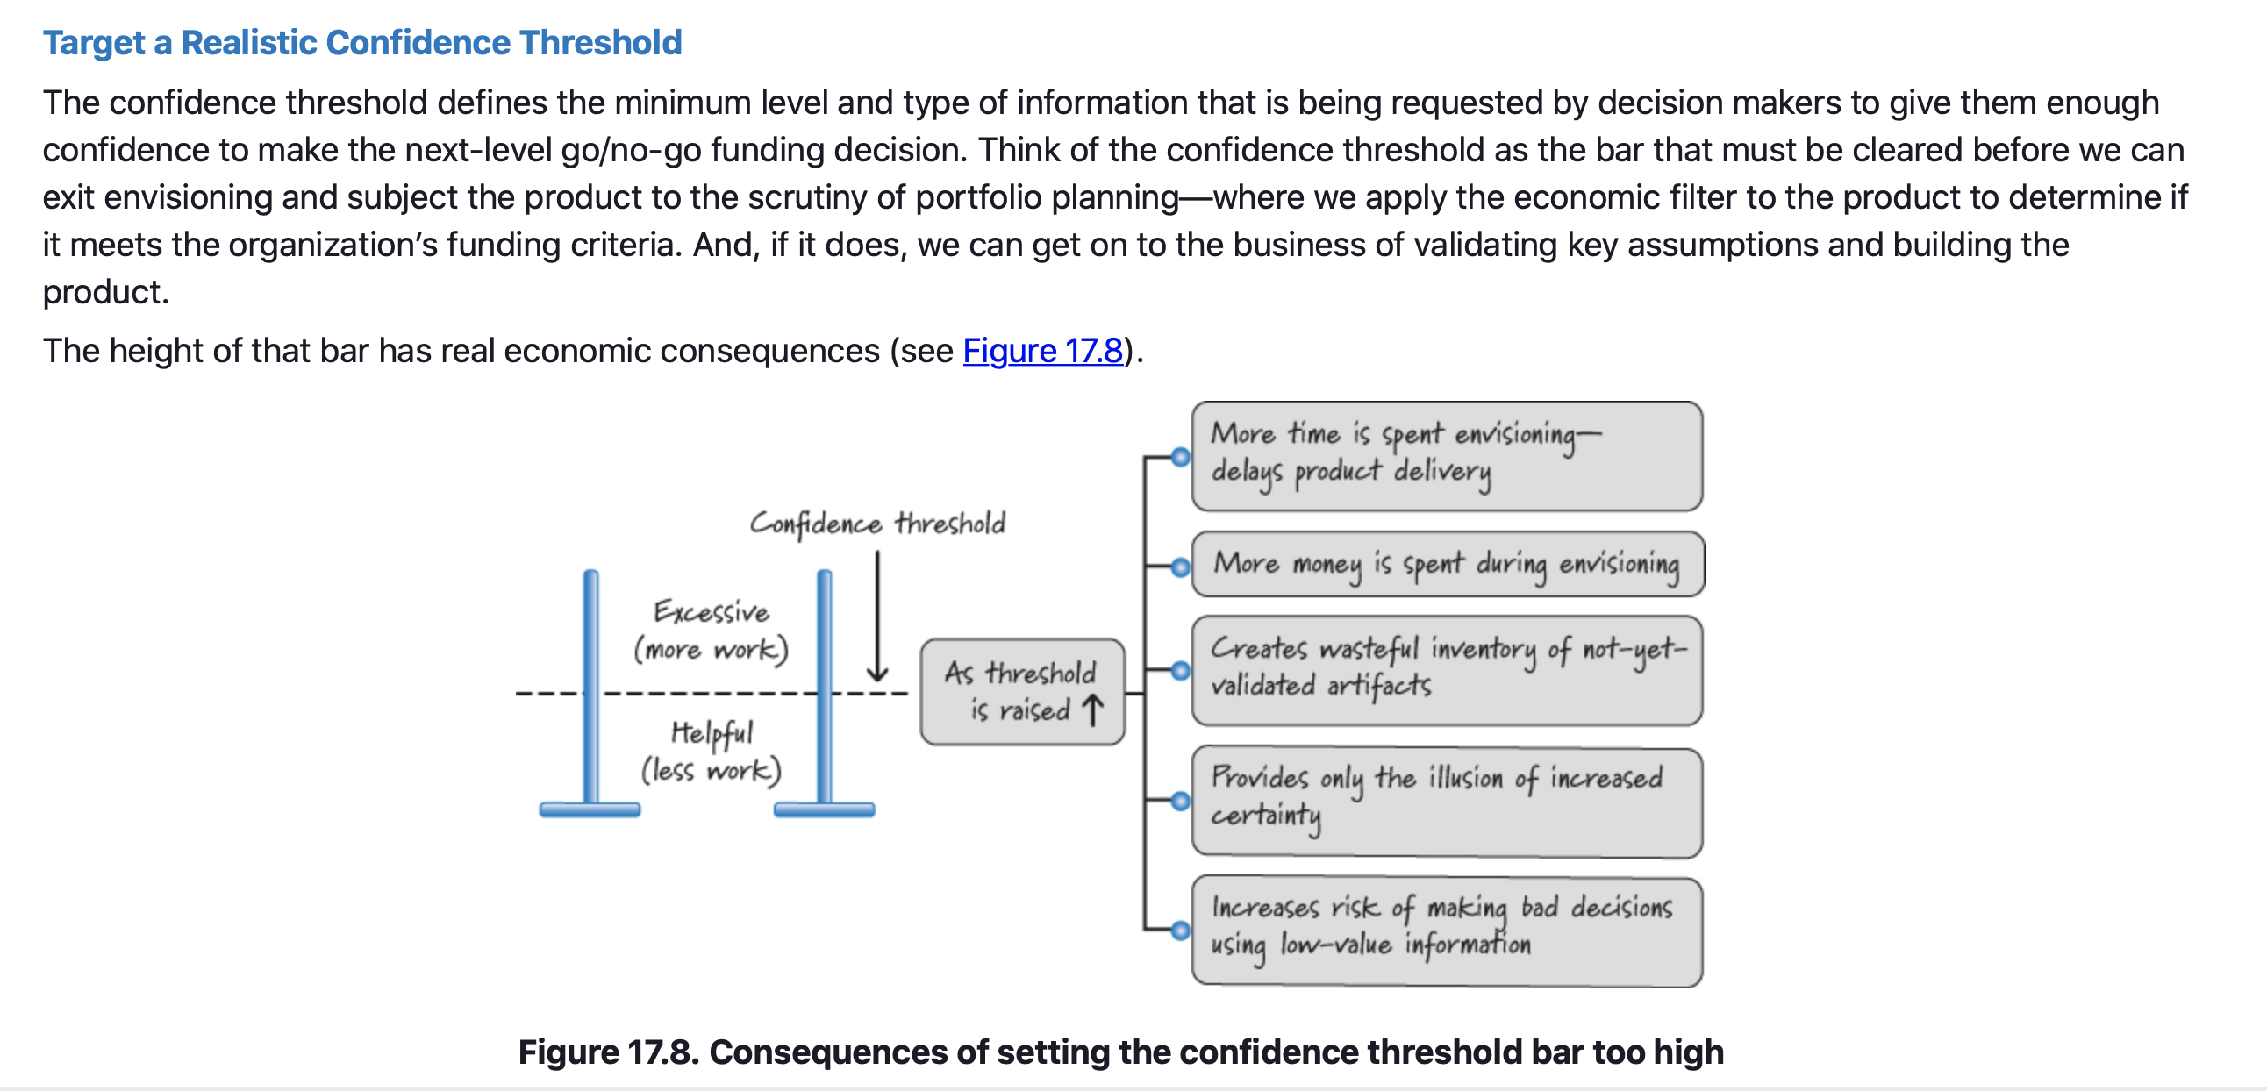
Product Planning – Economically Sensible Envisioning

Slide 29
Product Planning – Economically Sensible Envisioning
Target a Realistic Confidence Threshold
The higher the bar, the more time we need to clear it.
Additional time spent during envisioning will likely delay when the product will ship, and that delay has a cost.
Envisioning time also has to be paid for, so the higher the bar, the greater the cost of clearing it.
More predictive work also creates additional WIP (inventory) that might easily be wasted when things change. And most of that WIP is not yet validated, so additional increases to the bar height don’t add any certainty to our efforts.
Finally, more work can actually increase our risk of making a bad decision to proceed because of the illusion of certainty established by the ever-increasing set of planning artifacts that get produced.
Notes:
As mentioned in Chapter 14, up-front planning should be helpful without being excessive, so we need to set the threshold to the helpful level, not to the excessive level. What exactly constitutes a helpful level versus an excessive level is organization and product specific. Some organizations are comfortable making decisions under very uncertain conditions while others require a high degree of certainty before proceeding.

Slide 30
Product Planning – Economically Sensible Envisioning
Focus on a Short Horizon
Don’t try to envision too much at one time.
Focus primarily on the must-have features of the first candidate release.
If we plan on a very broad horizon, chances are we are wasting our time planning for things that might never happen.
Plus, if we are developing a new, innovative product, most of our assumptions are not yet validated, so it is very likely that when we subject our product to the uncertain customer environment, we will learn something important that will motivate us to adapt our vision and the plans of what we are building.

Slide 31
Product Planning – Economically Sensible Envisioning
Act Quickly
Envisioning should not be a long, drawn-out process, it should be fast and efficient.
The quicker we finish, the sooner we get to building something tangible that we can use to validate whether our understandings and assumptions are correct or not.
Time spent envisioning should be included in the calculation of the time required to deliver a solution.
The market clock starts ticking the moment the business opportunity becomes known (when the idea is generated) and doesn’t stop ticking until we deliver the product. An unnecessarily long envisioning activity will delay product delivery, and that delay cost might be quite expensive.

Slide 32
Product Planning – Economically Sensible Envisioning
Pay for Validated Learning
Evaluate envisioning activities from an economic perspective based on how they contribute to the acquisition of validated learning regarding the target customer, the target set of features, or the solution.
Thus, the organization should be willing to pay for the cost associated with these activities.
Be wary about performing predictive activities that generate information with a high degree of uncertainty—information that is believed to be valid but has not yet truly been validated with customers or users.
These activities purchase low-value information and are not only a bad return on investment; they are also potentially quite wasteful if once we get validated learning we end up discarding or reworking highly uncertain information that is wrong.

Slide 33
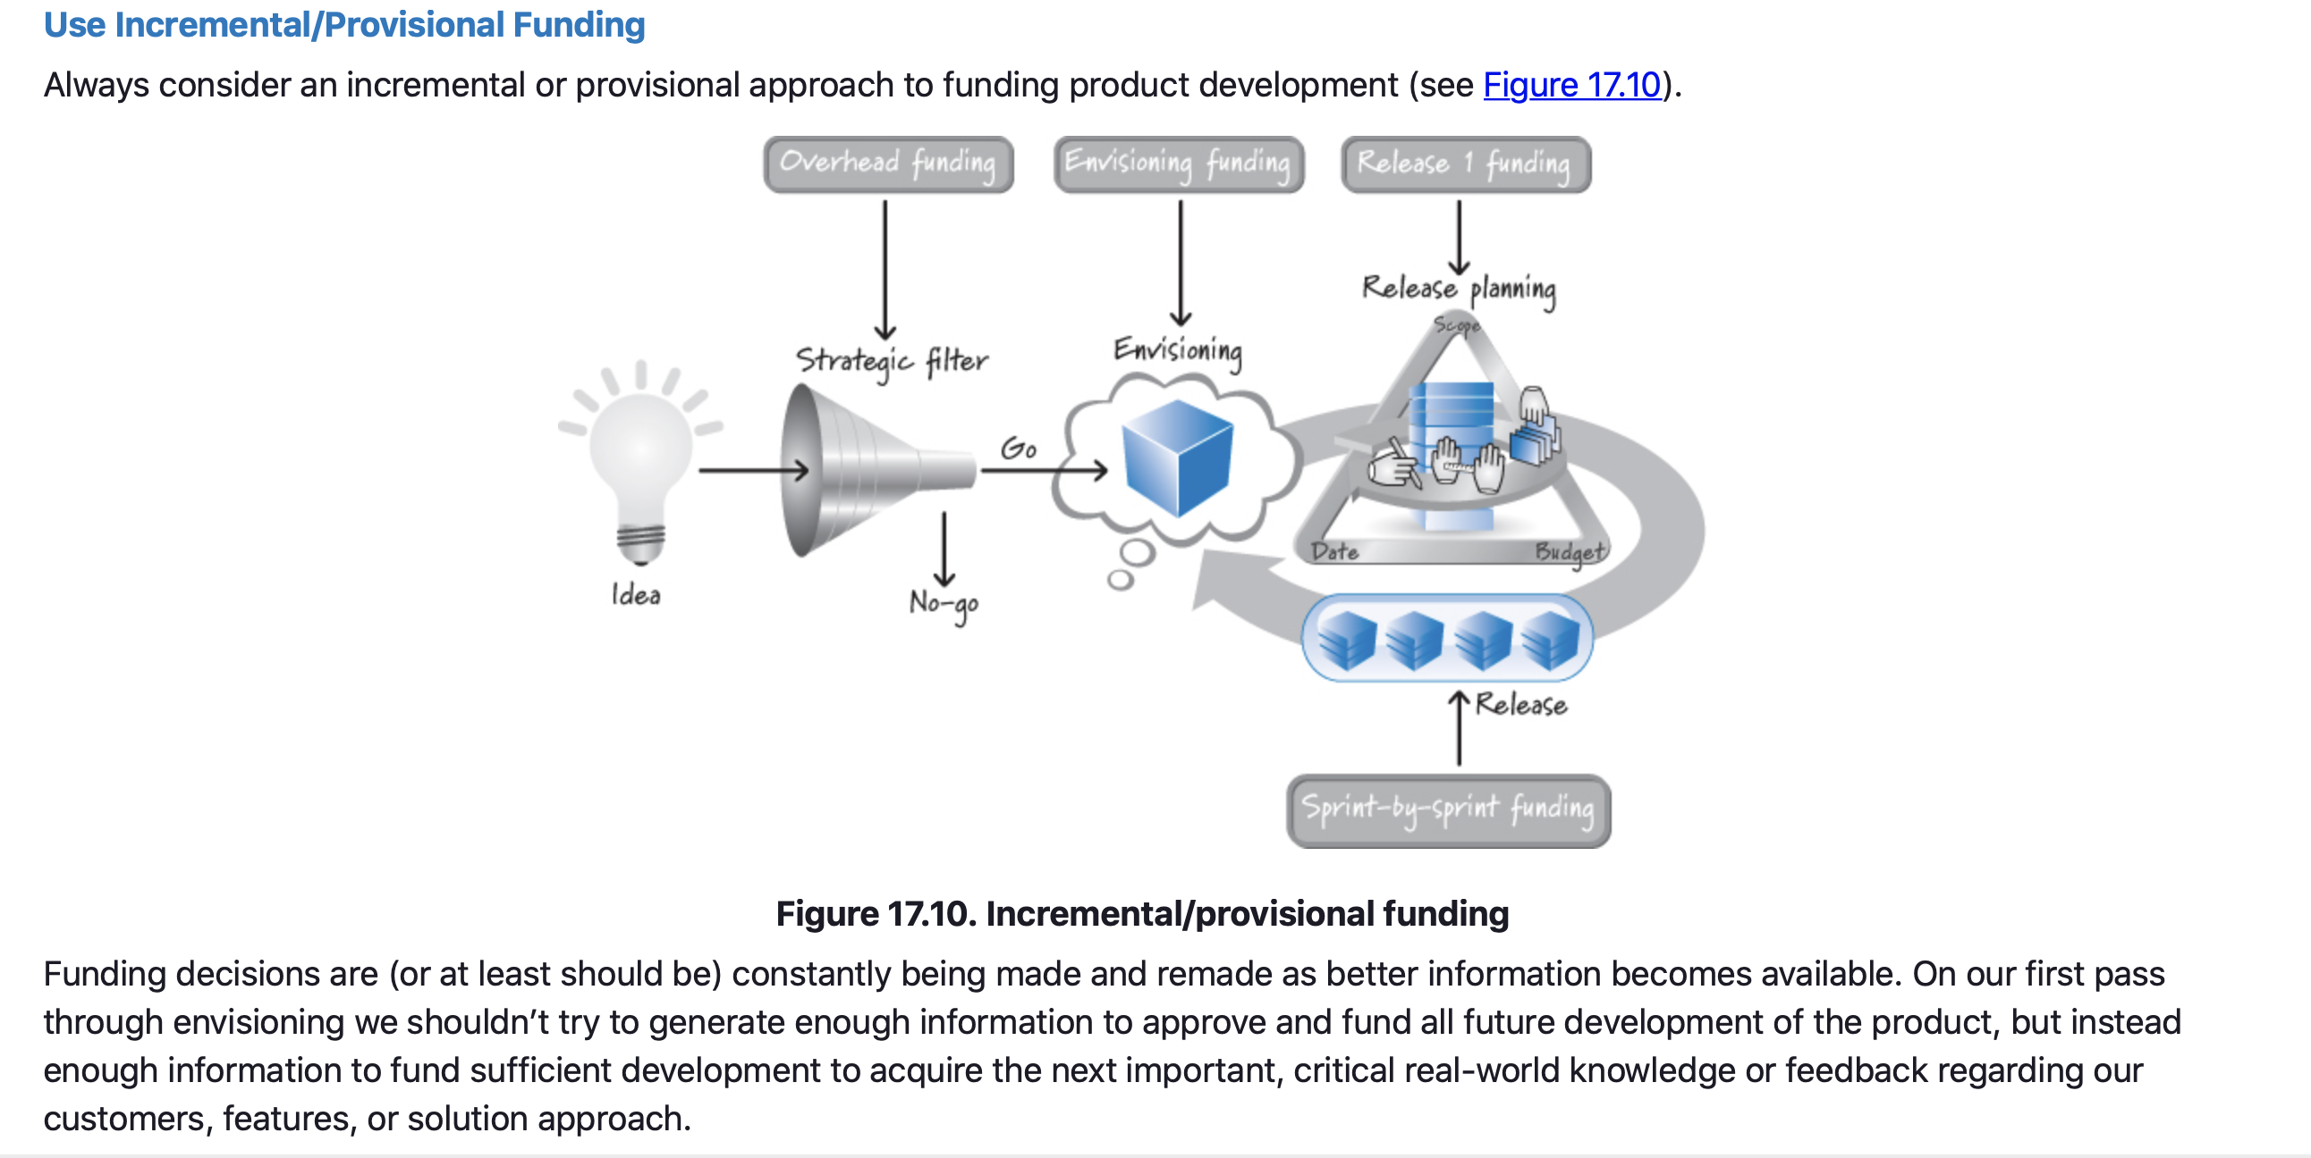
Product Planning – Economically Sensible Envisioning

Slide 34
Product Planning – Economically Sensible Envisioning
Learn Fast and Pivot (aka Fail Fast)
Envisioning is part of a learn-fast-and-pivot cycle.
This approach is sometimes referred to by the catchy alliteration fail fast.
Simply put, we responsibly and efficiently manage our resources to quickly and cheaply perform envisioning.
Then we quickly and cheaply validate our customer, feature, and solution knowledge and assumptions to see whether our vision and product plans meet our business expectations.
If we learn that they don’t, we pivot quickly and re-envision a more appropriate version of the product, or we simply kill the product and halt any further expenditure.

Slide 35
Product Planning – Closing
Covered a detailed description of envisioning (product-level planning).
Illustrated an approach to envisioning by showing how a fictitious company might create a product vision, high-level product backlog, and product roadmap for its SmartReview4You service.
Illustrated how a knowledge-acquisition sprint during envisioning can be useful in achieving the confidence threshold for completing envisioning.
Provided guidance on how to perform economically sensible envisioning so that we can better align the up-front product-planning work with the Scrum customer-value-creation work that will follow.

Slide 36
Release planning
Chapter 18

Slide 37
Release Planning
Chapter Outline
Overview
  Timing
  Participants
  Process
Release Constraints
  Fixed Everything
  Fixed Scope and Date
  Fixed Scope
  Fixed Date
  Variable Quality

Slide 38
Release Planning
Chapter Outline
Grooming the Product Backlog
Fixed-Date Release Planning
Fixed-Scope Release Planning
Calculating Cost
Closing

Slide 39
Release Planning - Overview
Release planning is longer-term planning that enables us to answer questions like “When will we be done?” or “Which features can I get by the end of the year?” or “How much will this cost?”
Release planning must balance customer value and overall quality against the constraints of scope, schedule, and budget.
In this chapter we discuss how release planning fits into the Scrum framework and how to perform release planning on both fixed-date and fixed-scope releases.
Every organization must determine the proper cadence for releasing features to its customers.
Though the output of a sprint is potentially shippable, many organizations choose not to release new features after every sprint. Instead, they combine the results of multiple sprints into one release.

Slide 40
Release Planning - Timing
Release planning is not a one-time event but rather a frequent, every-sprint activity.
Initial release planning logically follows envisioning/product-level planning.
The purpose of product planning is to envision what the product should be; the aim of release planning is to determine the next logical step toward achieving the product goal.
Before starting a release, many organizations that use Scrum conduct initial release planning to create a preliminary release plan.
When developing a new product, this initial release plan won’t be complete or too precise. Instead, as validated learning becomes available during the release, we update the release plan.
Release plans can be revised as part of each sprint review or in the normal course of preparing for and conducting each subsequent sprint.

Slide 41
Release Planning - Participants
Release planning involves collaboration between the stakeholders and the full Scrum team.
At some point all of these people have to be involved because they’ll need to make business and technical trade-offs to achieve a good balance of value and quality.
Each person’s exact involvement over time may vary.

Slide 42
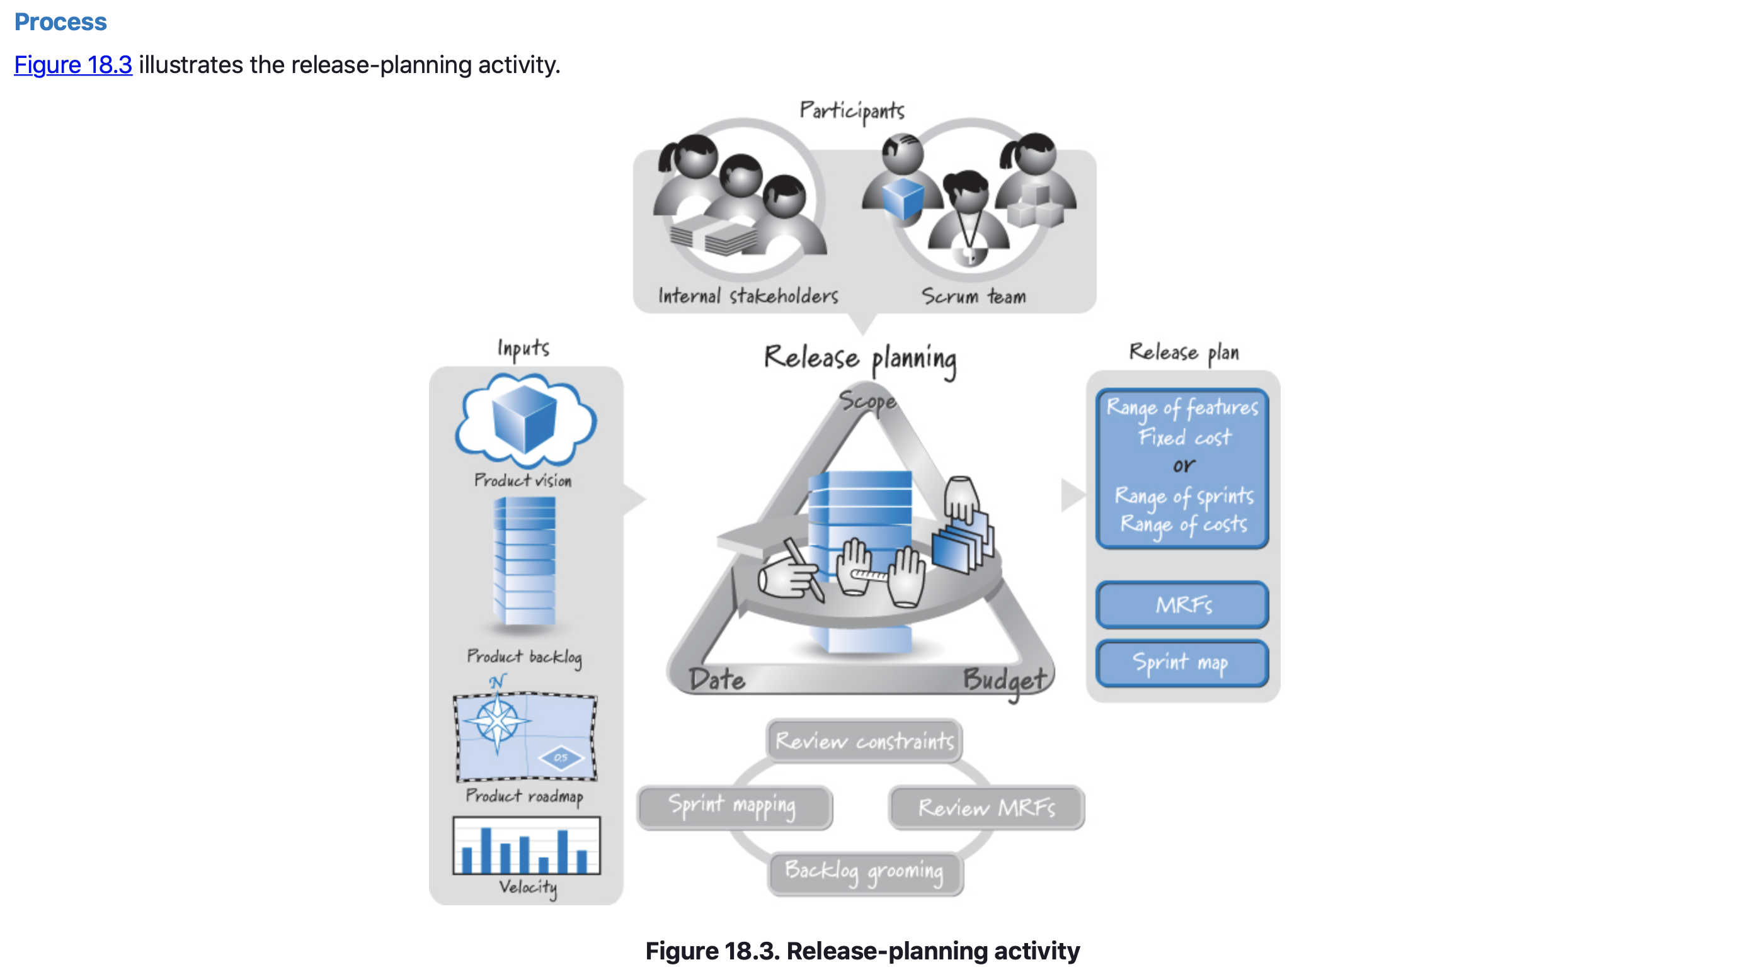
Release Planning - Process

Slide 43
Release Planning – Release Constraints
The goal of release planning is to determine what constitutes the most valuable next release and what the desired level of quality is.
The constraints of scope, date, and budget are important variables that affect how we will achieve our goal.
A constraint, in project management, is any restriction that defines the limitations of a project.
Based on product planning, one or more of these constraints will probably be established.
In the product roadmap for SR4U, Roger and his team determined that it would be advantageous to release the first version of SR4U at an upcoming conference, the Social Media Expo.
Thus, SR4U Release 1.0 has a fixed-date constraint—the release must be ready by a certain date: the Social Media Expo.
The other constraints (scope and budget) are flexible.

Slide 44
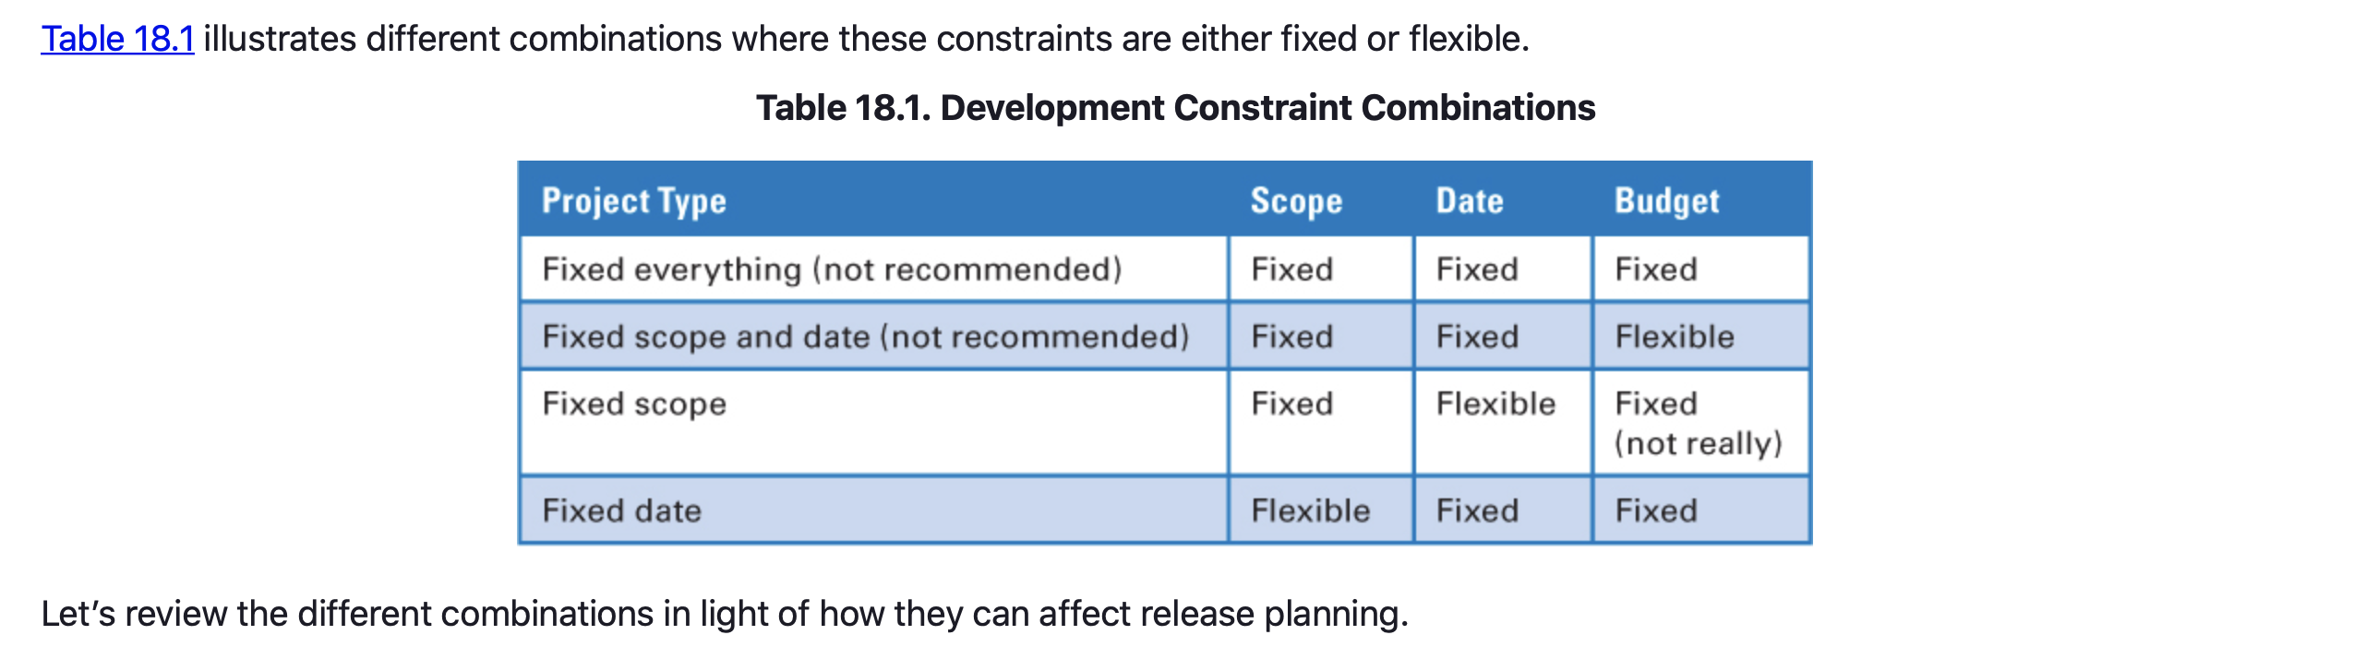
Release Planning – Release Constraints

Slide 45
Release Planning - Release Constraints
Fixed Everything
As described in Chapter 3, traditional, plan-driven, predictive development approaches assume that the requirements are known or can be predicted up front and that the scope won’t change.
Based on these beliefs, we can create a complete plan and then estimate the cost and schedule. In Table 18.1 this approach is called “fixed everything.”
In Scrum, we don’t believe it’s possible to get it all right up front; consequently, we also contend that a fixed-everything approach probably won’t work.
When doing release planning for product development with Scrum, we require at least one of these variables to be flexible.

Slide 46
Release Planning - Release Constraints
Fixed Scope and Date
One approach is to fix both the scope and the date and let the budget be flexible, which has a number of issues.
First, in many organizations, increasing a budget once development has begun isn’t very easy or likely.
Second, in my experience, this approach locks down two variables that are very difficult to predefine.
In practice, even if we start off believing we have a fixed-scope-and-date release, one of them will give.

Slide 47
Release Planning - Release Constraints
Fixed Scope and Date
As an example, many organizations working on mitigating the Y2K issues had a fixed set of applications that needed to be updated no later than December 31, 1999.
Many fixed time and scope; the budget was their variable.
In the end, however, they knew that no matter how much they increased their budget, they still weren’t going to complete all the work by the hard deadline of December 31.
The date wasn’t moving, so the scope did. In a sense, the variables of date and scope are constantly playing a game of chicken with each other.
At some point when time starts running out, either the scope or the date needs to give way. If neither does, the resulting crash will likely generate large technical debt.

Slide 48
Release Planning - Release Constraints
Fixed Scope
A fixed-scope model is appropriate where the scope truly is more important than the date.
In this model, when we run out of time and we haven’t completed all of the features, we extend the date to ensure that we get everything required to meet the MRFs criteria.
If we provide more time to complete the fixed scope, we also have to provide more budget to pay people during that extra time.
Frequently, a fixed-scope scenario exists because the overall scope is too large. A better solution might be to consider smaller, more frequent fixed-date releases.

Slide 49
Release Planning - Release Constraints
Fixed Date
This approach most closely aligned with Scrum principles. Simply put, we can fix both the date and the budget, but the scope must be flexible.
The Scrum principle of creating the highest-priority features first should lessen any perceived pain of having to drop features.
When we run out of time on a fixed-date release, whatever hasn’t yet been built should be of lower value than what has already been built.
It is much easier to make a decision to ship if the features that are missing are low value.
If we are missing high-value features, we’ll most likely extend the date if we can.

Slide 50
Release Planning - Release Constraints
Fixed Date
This works only when the high-priority features are truly done, per our agreed-upon definition of done.
We don’t want a scenario where the high-value, must-have features are really only 75% to 90% done and then we then have to drop one or two of them from the release in order to get the others to the 100% done level.
A fixed-date model becomes even easier to use if we can define a set of minimum releasable features that truly is small.

Slide 51
Release Planning - Release Constraints
Fixed Date
If we can comfortably deliver the MRFs by the fixed date, we are in good shape, because any other features, by definition, are only nice-to-have features.
Fixed-date releases also dovetail nicely with the Scrum emphasis on timeboxing.
By establishing a fixed amount of time for the release, we constrain the amount of work we can do and force people to make the difficult prioritization decisions that have to be made.

Slide 52
Release Planning - Release Constraints
Variable Quality
If we overly constrain scope, date, and budget, quality becomes “flexible.”
This can lead us to deliver a solution that fails to meet customer expectations.
Flexible quality can result in the accrual of technical debt, which makes it more difficult in the future to add to or adapt our product.

Slide 53
Release Planning – Grooming the Product Backlog
A fundamental activity of release planning is grooming the product backlog to meet our value and quality objectives.
During envisioning (product planning) we create a high-level product backlog (perhaps with epic-level stories) and then use it to define a set of minimum releasable features for each release.
Many of these backlog items are too large to be useful during release planning.
To refine them Roger and his team would conduct a user-story-writing workshop as part of the release-planning meeting or perhaps a separate story-writing workshop before the release-planning meeting.
Once the stories are small enough, the team would estimate them to communicate a rough idea of the cost.

Slide 54
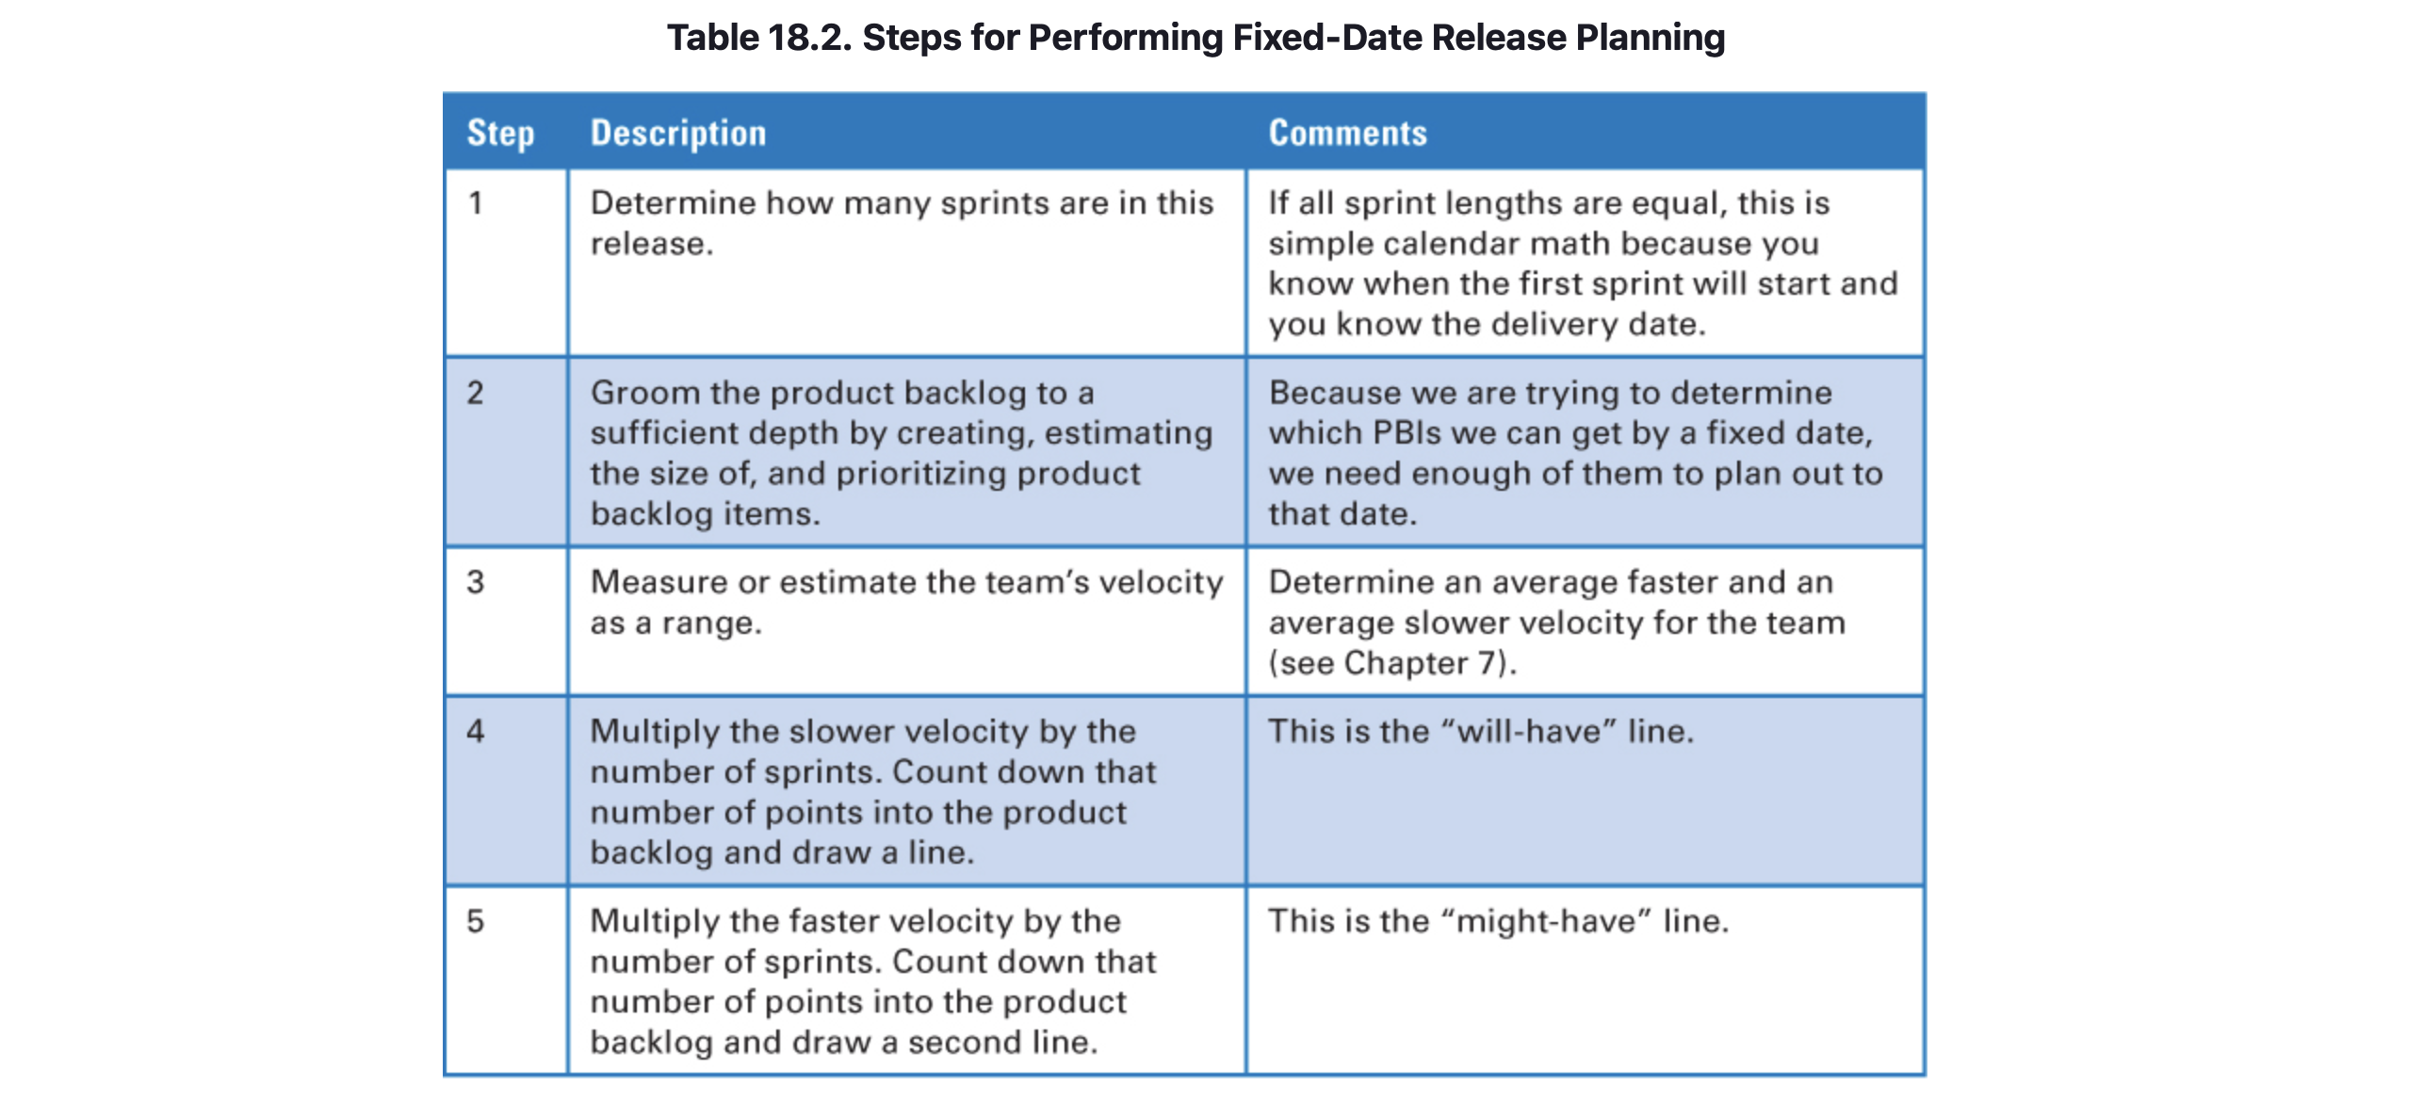
Release Planning – Fixed-Date Release Planning
As previously discussed, many organizations that use Scrum prefer to use fixed-date releases. Table 18.2 summarizes the steps for performing fixed-date release planning.

Slide 55
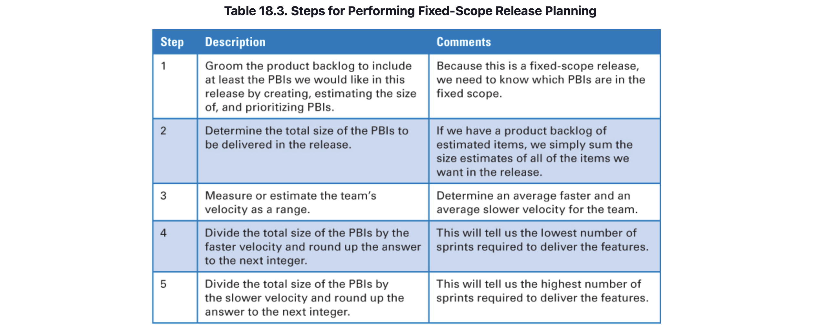
Release Planning – Fixed-Scope Release Planning
Although fixed-date releases are very common with Scrum, what if for your product the scope truly is more important than the date? What if you have a large set of must-have features in your minimum releasable features set and you’re willing to slip the delivery date to get them all?

Slide 56
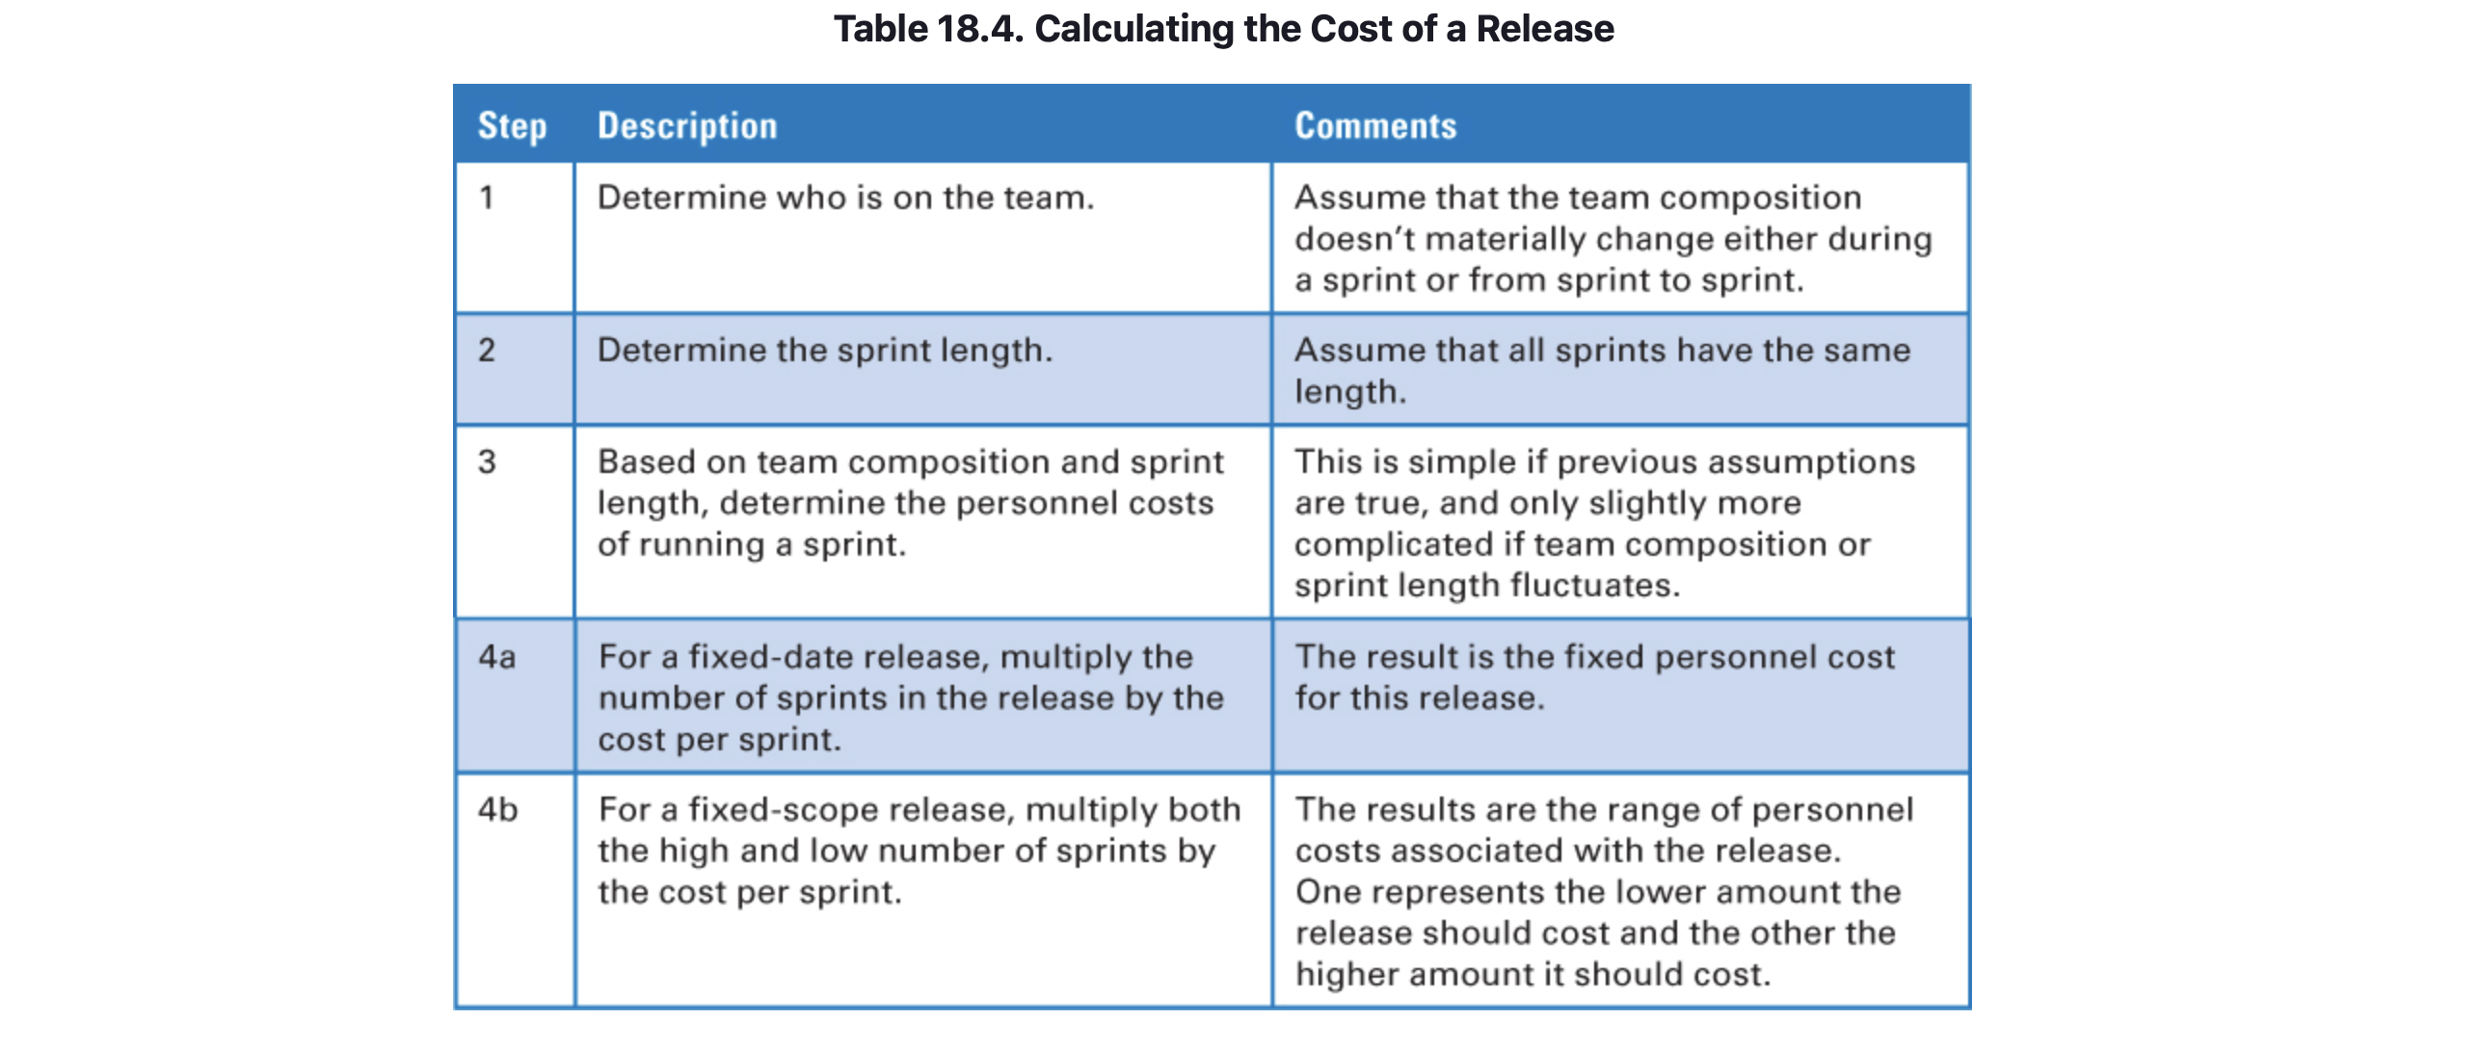
Release Planning – Calculating Costs
Calculating costs on either a fixed-date or fixed-scope release is easy (see Table 18.4).

Slide 57
Release Planning – Closing
Covered the description of release planning by discussing when release planning takes place, who is involved, what activities take place, and the elements of the resulting release plan.
Discussed the details of how to do both fixed-date and fixed-scope release planning.
This chapter concludes Part III – Planning.

Slide 58
Sources
Unless otherwise noted, all material in these slides were used from the textbook for this course:
Rubin, Kenneth S., Essential Scrum: A Practical Guide to the Most
Popular Agile Process, 1st Edition. Addison-Wesley Professional; 1st
edition (August 5, 2012). ISBN-13: 978-0137043293.

